Slide 1

Containerized And Orchestrated Microservices
Improving Our Environment
SoftUni Team
Technical Trainers
Software University
https://softuni.bg

Slide 2
Table of Contents
Containers And Docker
Docker CLI
Source Code in Containers
Building a Custom Image
Linking Containers in Networks
Orchestrating Containers with Compose

Slide 3
Questions
sli.do #microservices

Slide 4

Containers And Docker

Slide 5
Containerization
Approach in which an application or service is packaged as an image
With its dependencies and configuration
The containerized application can be tested and deployed as a unit to the host OS
Allows deployments across environments with little or no modification
Containers also isolate applications from each other on a shared OS
The containers runs on a container host
The container host runs on an OS (Linux or Windows)
Thus having a smaller footprint than virtual machines

Slide 6
Docker
Docker is lightweight, open, secure
It simplifies building, shipping, and running applications
On different environments
Runs natively on Linux or Windows servers
Runs on Windows or Mac development machines
Relies on "images" and "containers"
The playground is a good starting point:
https://www.docker.com/play-with-docker

Slide 7
Docker
Image
An image is just like a blueprint
A read-only template
Contains the building blocks of an application
Framework, dependencies and code are "described" here

Slide 8
Docker
Container
Built from the image
It is the actual running environment for your application
Isolated and secured
It can be started, stopped, moved, and deleted
You create a container for your different application pieces
Database, Presentation, Caching, etc.

Slide 9
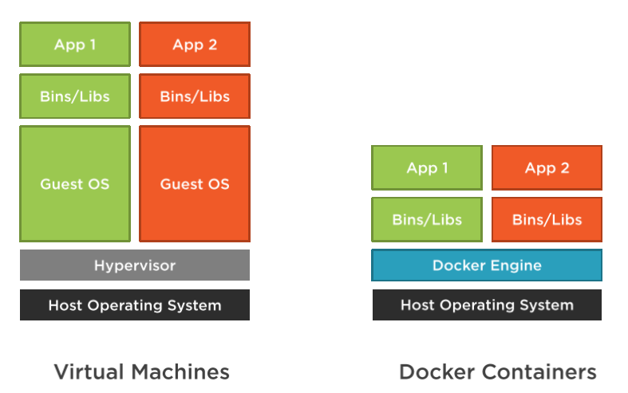
Docker

Slide 10
Docker
Docker Desktop
Runs on Windows or Mac development machines
Includes Docker Engine, CLI and Kubernetes
Containerize and share any application
Complete Docker development environment
On Windows
Ability to switch between Linux and Windows Server environments
Supports Pro, Enterprise, and Education versions
For Home – you can only run Linux containers through WSL 2
There are third-party solutions for Linux – DockStation, CairoDock, and more…

Slide 11
Docker
Docker Hub
Cloud-based application registry
Development team collaboration services
Supports public and private repositories
The world’s largest library of container images
Automated builds and webhooks
https://hub.docker.com/

Slide 12
Development Process
Developers create an application
The application is packaged with its dependencies as an image
The image is instantiated to create a container
Containers are initially tested on the development machine’s Docker host
Developers store images in a registry
These images are used by the production orchestrators

Slide 13
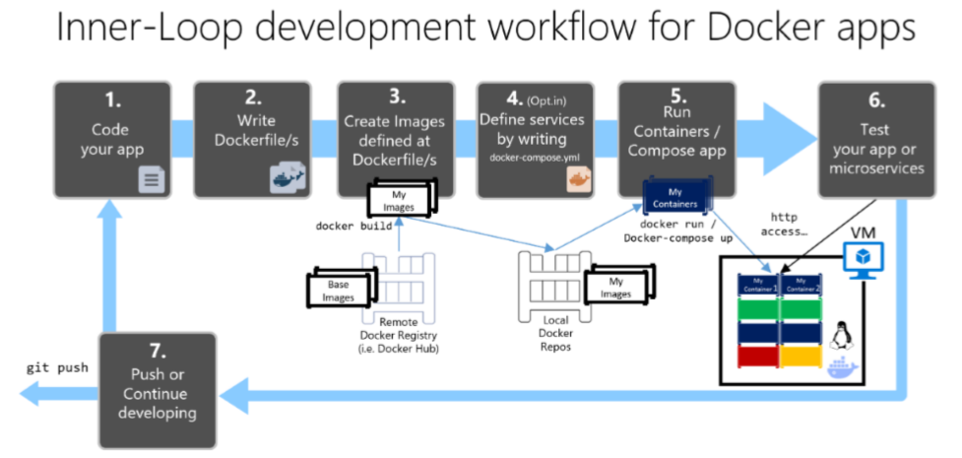
Development Process

Slide 14
Docker CLI

Slide 15
Docker CLI
Docker CLI allow you to work with the Docker Engine
Build and manage images
Run and manage containers
Example commands:
docker pull [image]
docker run [image]
docker images
docker ps
docker logs [container]

Slide 16
Docker CLI
Let’s download a sample NGINX server
To run it, we need to expose ports from the container:
Go to localhost:5000 and see the server
You may run in detached mode with a name:
Or with clean-up after stopping
docker pull nginxdemos/hello
docker run -p 5000:80 nginxdemos/hello
docker run -p 5000:80 –d --name code_it_up nginxdemos/hello
docker run -p 5000:80 –d --rm nginxdemos/hello

Slide 17
Docker CLI
To see all running containers you need the ps command:
To show all ran containers:
To see all images
Remove the container, because it is not super impressive:
Remove the image too:
docker ps
docker ps -a
docker images
docker rm [container id]
docker rmi [image id]

Slide 18
Source Code In Containers

Slide 19
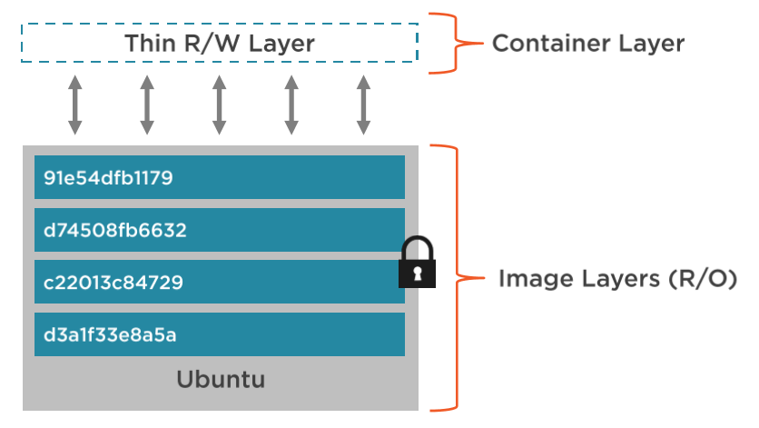
Layered File System
Each image has file system layers, which are read-only and isolated

Slide 20
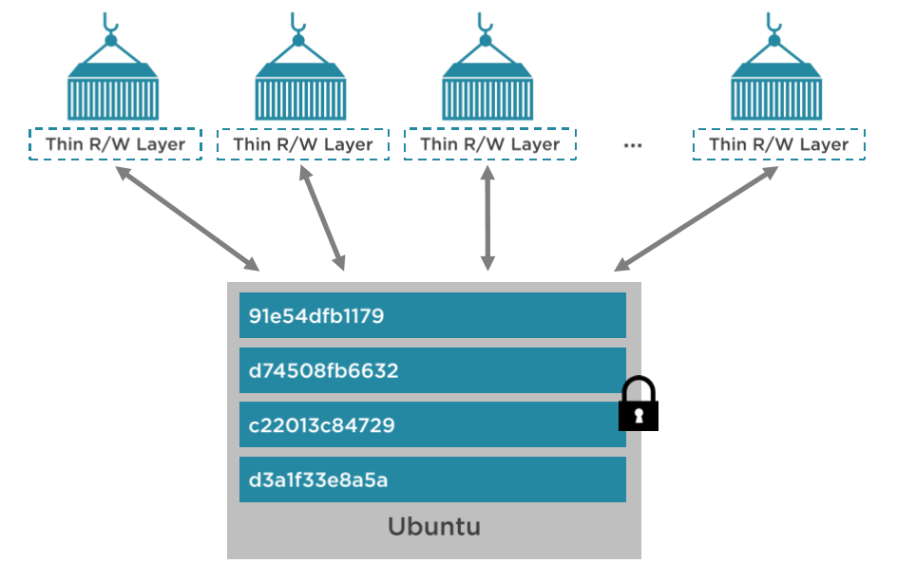
Layered File System
Containers share image layers
Therefore they load faster once you have them

Slide 21
Volumes
By default the writable file system of the container is deleted after you run the stop command
Which is not very suitable for persistence operations
Volumes to the rescue
Special type of directory in a container
Mapped to the real file system
Can be shared and reused among containers
Updates to the image won’t affect volumes
Persisted even after the container is deleted
You have full control over them

Slide 22
ASP.NET Core In Container
Create a new ASP.NET Core MVC application
Navigate to the application folder:
dotnet new mvc -n MyWebSite
cd MyWebSite

Slide 23
ASP.NET Core In Container
Pull the ASP.NET Core 3.1 image:
Set the application’s default port in launchSettings.json:
docker pull mcr.microsoft.com/dotnet/core/sdk:3.1
"MyWebSite": {
"commandName": "Project",
"environmentVariables": {
"ASPNETCORE_ENVIRONMENT": "Development",
"ASPNETCORE_URLS": "http://+:80"
}
}

Slide 24
ASP.NET Core In Container
Run the application locally first and go to https://localhost:80
We are going to use the container’s terminal:
Inside the inner terminal enter dotnet run
(make sure the project targets 3.1)
Go to localhost:5000 to validate the application
dotnet run
docker run -it `
-p 5000:80 `
-v ${PWD}:/app `
-w /app `
mcr.microsoft.com/dotnet/core/sdk:3.1 /bin/bash # dotnet run

Slide 25
Building A Custom Image

Slide 26
Building A Custom Image
Dockerfile is the way to create custom images
Contains build instructions
These instructions create an intermediate image that can be cached to increase future builds
Used with the docker build command
It is like compiling a source code

Slide 27
Building A Custom Image
Key instructions for getting started:
FROM – create an image from another image (supports multi-staging)
LABEL – adds metadata in a key-value pair fashion
RUN – execute different command, like npm install, for example
COPY – copy different files in the image, like your source code
ENTRYPOINT – defining which command starts the container
WORKDIR – the working directory of the image, where are your files
EXPOSE – to expose a port externally
ENV – defining environment variables, like database connection strings
VOLUME – defining a volume for the container
CMD – execute a command-line operation

Slide 28
Building A Custom Image
FROM node
LABEL maintainer="Code It Up"
COPY . /app
WORKDIR /app
RUN npm install
EXPOSE 4200
ENTRYPOINT ["ng", "serve"]

Slide 29
Building A Custom Image
Build an image from the current directory
Check the new image
Run your image in a container
Go to localhost:3000 and validate the application
docker build . -t softuni/my_app #-f for different dockerfile name
docker images
docker run -p 3000:4200 softuni/my_app

Slide 30
Building A Custom Image
RUN executes command in a new layer
Used for installing packages, for example
Multiple RUN commands are acceptable
CMD sets a default command to execute when the container runs
It can be overridden from the terminal
ENTRYPOINT configures a container that will run as an executable
It is not meant to be overridden from the terminal
More information is available here:
https://goinbigdata.com/docker-run-vs-cmd-vs-entrypoint/

Slide 31
Linking Containers In Networks

Slide 32
Setup A Database Container
Pull a SQL Server 2019 image:
Run it with the following command:
You can connect to it through 127.0.0.1, 1433
Note: disable host’s SQL Server instances or use another port!
docker pull mcr.microsoft.com/mssql/server:2019-latest
docker run `
-e ACCEPT_EULA=Y `
-e SA_PASSWORD=yourStrongPassword12#$ `
-p 1433:1433 `
-d mcr.microsoft.com/mssql/server:2019-latest
32

Slide 33
Setup A Database Container
By default the data is not persisted after stopping the container:
We need to create a volume:
You can then easily backup/restore the data from the volume
docker run `
-e ACCEPT_EULA=Y `
-e SA_PASSWORD=yourStrongPassword12#$ `
-p 1433:1433 `
-v sqldata:/var/opt/mssql `
-d mcr.microsoft.com/mssql/server:2019-latest
33
33

Slide 34
Create A Network
To link containers, we need to create a network first
Then in our run command we need to provide the network and a container name:
Then you can inspect your network:
docker network create my_network
docker run --network my_network --name mycontainer [container name]
docker network inspect my_network
34
34

Slide 35
Create A Network
Let’s add the SQL Server container to our network:
Inspect the network:
docker run `
-e ACCEPT_EULA=Y `
-e SA_PASSWORD=yourStrongPassword12#$ `
-p 1433:1433 `
-v sqldata:/var/opt/mssql --rm --network my_network --name sqlserver `
-d mcr.microsoft.com/mssql/server:2019-latest
docker network inspect my_network
35
35

Slide 36
Create A Network
Add a Dockerfile and build the image:
Run the image in a container and attach it to our network:
Go to localhost:5000 to validate the application
docker build -f "./MySite/Dockerfile" -t codeitup/asp-data-app .
docker run `
-p 5000:80 --rm `
--name web_app `
--network my_network `
codeitup/asp-data-app
36
36

Slide 37
Orchestrating Containers with Compose

Slide 38
Docker Compose
Manages the whole application lifecycle
Consider a service to be a container you manage
Start, stop and rebuild services
View the status of running services
Stream the log output of running services
Run one command to run your application

Slide 39
Docker Compose Workflow
Define a docker-compose.yml file
Describe your services you are going to use
Define the networking rules
Build your services
Start up your services
Manage your services

Slide 40
Docker Compose Workflow
Just add a docker-compose.yml file in your solution
The first line defines the version of the file:
Then normally you define services with various options:
build – allows you to build an image from a Dockerfile
environment – gives you the ability to set environment variables
image – set a ready to be used image
network – associate a service with a network
ports – options to expose ports
volumes – associate a volume with a service
version: "3.8"

Slide 41
Docker Compose Workflow
Commonly used commands:
docker-compose build – builds all images
docker-compose up – runs all services
docker-compose down – stops all services
docker-compose logs – show service logs
docker-compose stop – stop a service
docker-compose start – start a service
And more…

Slide 42
Docker Compose Workflow
Build the images:
Run the containers:
Or in “silent” mode:
Check whether the services are up and running:
docker-compose build
docker-compose up
docker-compose up -d
docker-compose ps

Slide 43
Docker Compose Workflow
Remove everything:
Compose with multiple files:
Redeploy a single service:
docker-compose down –-rmi all --volumes
docker-compose -f docker-compose.yml -f production.yml up -d
docker-compose build web
docker-compose up --no-deps -d web

Slide 44
Adding SQL Server
data:
container_name: sqlserver
image: mcr.microsoft.com/mssql/server:2019-latest
ports:
- "1433:1433"
env_file: Server/CarRentalSystem/common.env
environment:
- ACCEPT_EULA=Y
- SA_PASSWORD=yourStrongPassword12!@
volumes:
- sqldata:/var/opt/mssql
networks:
- carrentalsystem-network

Slide 45
Adding RabbitMQ
messages:
container_name: rabbitmq
image: rabbitmq:3-management
ports:
- "15672:15672"
- "5672:5672"
hostname: "rabbitmq"
environment:
- RABBITMQ_ERLANG_COOKIE=Rand0mR4bbitMqCo0k1e
- RABBITMQ_DEFAULT_USER=rabbitmq
- RABBITMQ_DEFAULT_PASS=rabbitmq
networks:
- carrentalsystem-network

Slide 46
Adding Common Variables
# Application Settings
ApplicationSettings__Secret="S0M3 M4G1C UN1C0RNS G3N3R4T3D TH1S S3CR3T"
# Connection strings are a bit different
ConnectionStrings__DefaultConnection=Server=sqlserver;Database=CarRentalIdentityDatabase;User Id=sa; Password=yourStrongPassword12!@;MultipleActiveResultSets=true
# Defining volumes and networks
volumes:
sqldata:
networks:
carrentalsystem-network:

Slide 47
Adding Common Environment Variables
identity:
container_name: identity
build:
context: ./Server
dockerfile: ./CarRentalSystem.Identity/Dockerfile
ports:
- "5003:80"
env_file: Server/CarRentalSystem/common.env
environment:
- ConnectionStrings__DefaultConnection=yourConnection
restart: on-failure
volumes:
- ./.aspnet/identity/DataProtection-Keys:/root/.aspnet/DataProtection-Keys
networks:
- carrentalsystem-network
depends_on: dependencies

Slide 48
Debugging
To debug an application in a container:
Set the Dockerfile to use the Debug configuration
In Visual Studio:
Debug -> Attach to Process
Choose Docker
Click Find -> Select the container
Choose Managed and wait

Slide 49

Summary
Containers And Docker
Docker CLI
Source Code in Containers
Building a Custom Image
Linking Containers in Networks
Orchestrating Containers with Compose
…
…
…

Slide 50
Questions?
Notes:
50

Slide 51

License
This course (slides, examples, demos, exercises, homework, documents, videos and other assets) is copyrighted content
Unauthorized copy, reproduction or use is illegal
© SoftUni - https://about.softuni.bg/
© Software University - https://softuni.bg
Notes:
51

Slide 52
Trainings @ Software University (SoftUni)
Software University - High-Quality Education, Profession and Job for Software Developers
softuni.bg, about.softuni.bg
Software University Foundation
softuni.foundation
Software University @ Facebook
facebook.com/SoftwareUniversity
Software University Forums
forum.softuni.bg
Notes:
52

